Slide 1

TV spots campaign
Impact on website visits

Slide 2
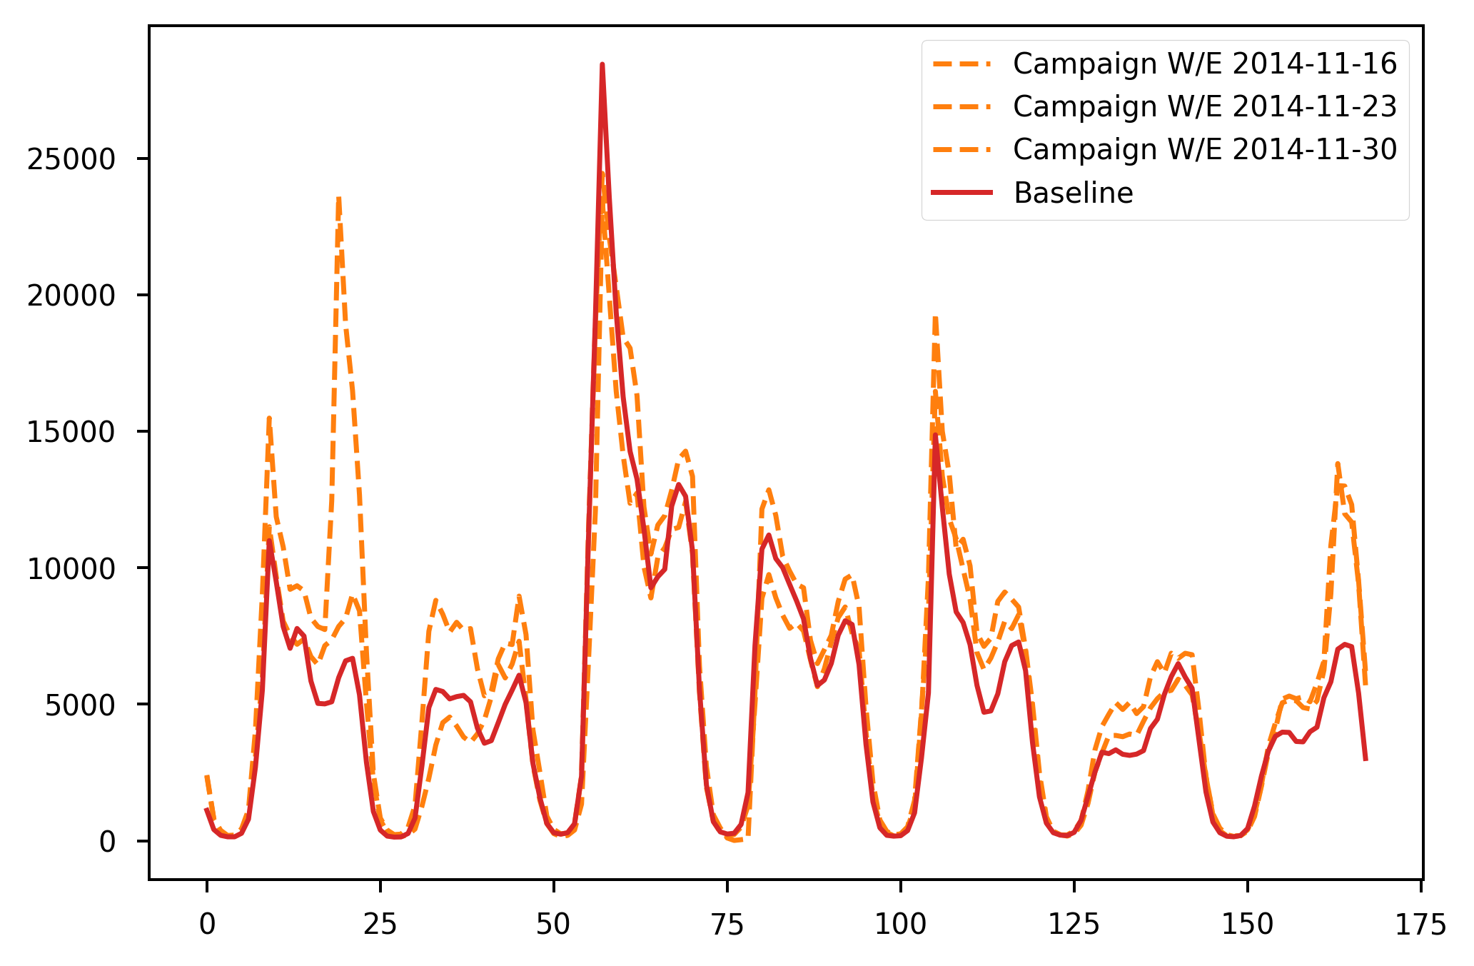
TV spots impact on website visits
Campaign and Post-Campaign website visits compared to baseline (Pre-Campaign)
There’s a positive impact on the website visits during and after the campaign (the chart on the left-hand side). There’re specific days of week with the biggest uplift: Monday and Sunday, while Wednesday doesn’t report any (the chart on the right-hand side).
Pre-Campaign: 1st October 2014 to 9th November 2014. Campaign: 10th November 2014 to 23rd November 2014. Post-Campaign: 24th November to 19th December 2014.

Slide 3
Most important TV spot features
Summary of the TV spot features having impact on the uplift to website visits
01
02
03
> 100%
> 50%
NO IMPACT
TV spots having more than 100% uplift were shown during Day timeband, on Monday and Tuesday, and between 18-22 or at Midnight.
For TV spots with under 100%, but more than 50% uplift the most important factors were Prime timeband and 18-22.
Analysis didn’t find any significant correlation between TV spot features like GRP, main TV channels. However, thematic TV channels had minor correlation with impact.

Slide 4
Model definition
The model was created by extracting baseline, calculating uplift, grouping into 4 classes and extracting features.
01
02
Baseline was created by calculating a median of hourly website visits for each week in the period before the campaign (1st October 2014 – 9th November 2014)
Classes defined based on uplift from baseline: <0 – no uplift, >0 – minimal uplift, >50% - greater than 50% from baseline, >100% - greater than 100% from baseline
Multi-class classification model using XGBoost with one-vs-rest strategy and optimized using GridSearch with StratifiedKFold cross-validation method.
Baseline
Classes
Classification

Slide 5
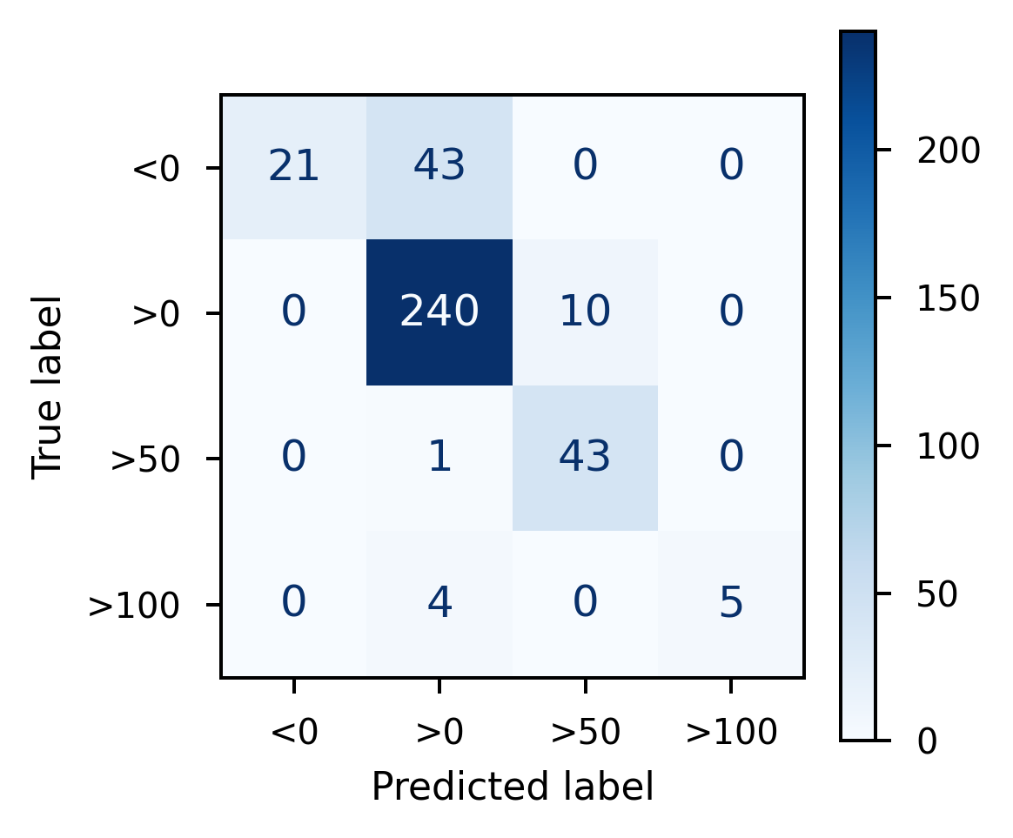
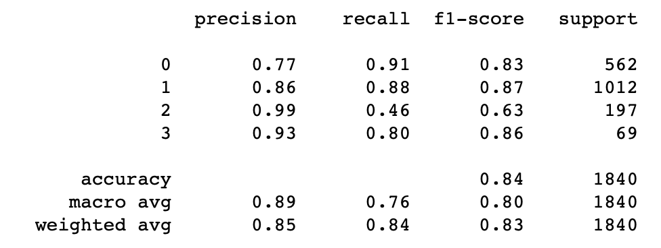

Model evaluation
F1-score and confusion matrix
Classification report – train set
Classification report – test set

